Slide 1
Analysis of human resources key competences and their development possibilities in the mechatronics field
INNOREG project
Client: Tallinn Enterprise Board
Executor: HeiVäl Consulting and project expert group
HeiVäl Consulting Kollane 8/10-7, 10147 Tallinn info@heival.ee www.heival.ee

Slide 2
TABLE OF CONTENTS
Overview of the study
Introduction
Objective
Execution
Project region: South-Finland and North-Estonia
Structure of the questionnaire
Structure of the report
Client and executor

Slide 3
TABLE OF CONTENTS
Overview of the study results
Introduction
Areas of human resources competency in the mechatronics field
Jobs in the mechatronics field
Grouping of jobs in the mechatronics field
Characterization of the sample
- Number of employees in the companies
- Companies’ revenues and profits
- Companies’ revenues per employee
- The relationship between company size and revenue per employee
- Companies’ profits per employee
- Profit per employee compared to the number of employees
- Profit compared to the number of workers in the mechatronics field
Summary of the characterization of the sample

Slide 4
TABLE OF CONTENTS
Introduction of the study results
Need for employees in the mechatronics field
Jobs needed today in the mechatronics field
Increase in the need for employees by jobs
Increase in the need for employees in 3 to 5 years
Numerical need for competences by job
Grouping of competences
Most needed competences today and in 3 to 5 years
Training provided by companies today and in 3 to 5 years
Volume of training today and in 3 to 5 years
Training needs
Training needs and supply
Companies’ requests to educational institutions
Requests for cooperation
Summary of the study results
Summary
Recommendations

Slide 5
OVERVIEW OF THE STUDY Introduction
The study ”Analysis of human resources key competences and their development possibilities in the mechatronics field” is organized within the framework of the INTERREG IVA project “INNOREG – The development of innovative business structures for ensuring competitiveness.”
INNOREG is an international project focusing on the South-Finland and North-Estonia region, the main objective of which is to increase the competitiveness of the region’s companies in the mechatronics field through shaping the technological platform, creating an innovation centre and improving the opportunities for cooperation.

Slide 6
OVERVIEW OF THE STUDY Objective
The objective of the study was to compile a quantitative analysis of the human resources in the mechatronics field in North-Estonia and South-Finland, which includes the following surveys:
1. Labour competences and levels in the mechatronics field by various jobs,
2. Competences of the in-service training carried out in the mechatronics field by North-Estonian educational institutions
and based on the results to work out recommendations for the development of human resources competences in the mechatronics field.

Slide 7
OVERVIEW OF THE STUDY Execution
In the course of the study the following were organized: from January to April 2012: survey of five companies in mechatronics field in North-Estonia and five in South-Finland (see figure 1 pg. 8) and two North-Estonian educational institutions and an analysis of the results. The final report on the study was compiled in April 2012.
The data collection method was an electronic questionnaire filled out by the respondents and face-to-face interviews.
This study was carried out as a pilot project, which, if necessary, will be followed by the same type of study with a larger sample group.

Slide 8
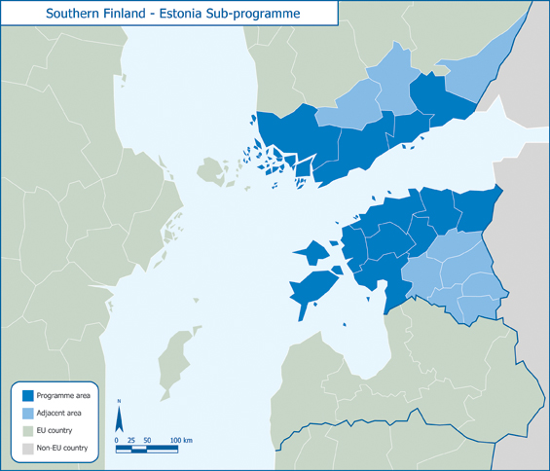
OVERVIEW OF THE STUDY Region covered by the project
South-Finland and North-Estonia
Project region
South-Finland
North-Estonia
Regions where the companies included in the sample are located
Project region Adjacent area EU country Non-EU country
Figure 1. Project region.
Source:http://www.centralbaltic.eu/programme, with HeiVäl Consulting additions

Slide 9
OVERVIEW OF THE STUDY Structure of the questionnaire
Two questionnaires were used to carry out the study – one for questioning the companies and the other for the educational institutions.
Both questionnaires were comprised of two parts: 1.) general information and 2.) competences. The first part determined the background of the organizations and the second part mapped the competences needed by companies in the mechatronics field and the competences taught by educational institutions.

Slide 10
OVERVIEW OF THE STUDY Structure of the report
The study report is based on the structure of the two questionnaires that were the basis for the survey and the results are divided into categories as follows:
Characterization of the sample
Companies’ needs for competences in the mechatronics field today
Companies’ needs for competences in the mechatronics field in 3 to 5 years
Competences in the mechatronics field taught by educational institutions today
Competences in the mechatronics field taught by educational institutions in 3 to 5 years

Slide 11
OVERVIEW OF THE STUDY Client and executor
The study on the key human resource competences in the mechatronics field in the North-Estonia and South-Finland region was commissioned by the Tallinn Enterprise Board and compiled by HeiVäl Consulting. The basis for executing the study was the initial assignment established by the client and the information provided at meetings, as well as the questionnaire developed by the executor in cooperation with the expert group. The companies were interviewed by the employees of HeiVäl Consulting and Koneteknologiakeskus Turku OY.
The study was executed by a working group of HeiVäl Consulting consultants, including the following:
Kaido Väljaots – consultant in the cluster field;
Tõnu Hein – technology consultant.
Ülly Aun – project manager for the study.

Slide 12
OVERVIEW OF THE STUDY RESULTS Introduction
This study was motivated by the need to clarify the needs of companies in the mechatronics field in North-Estonia and South-Finland related to development of the competences of production employees.
Mechatronics is a technical field dealing with interaction of mechanical, electronic and information systems (see figure 2 pg. 13).

Slide 13
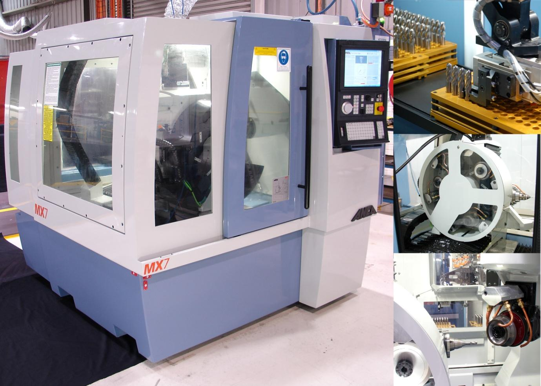
OVERVIEW OF THE STUDY RESULTS Areas of competency in the mechatronics field
Control systems
Micro-
processors
Sensors
Com-puters
Elec-tronics
MECHATRONICS
Electro-
Mechanics
CAD/CAM
Electro- and precision-mechanics
CAD/CAM
PERSONAL AND
TEAM SKILLS
Mechanics
Source: TUT, with HeiVäl Consulting additions
Figure 2. Areas of human resources competency in the mechatronics field.

Slide 14
OVERVIEW OF THE STUDY RESULTS Jobs in the mechatronics field
The jobs in the mechatronics field can be divided into four main groups (see figure 3, pg. 13):
Equipment that is numerically controlled
Automatic control systems
Local automated solutions
Assembly of equipment
Jobs are divided into three levels: engineers, middle management and specialists.
The engineers are the ones that deal most with the integration of the mechanics, electronics and information technology systems, the middle managers and specialists are less involved.

Slide 15
OVERVIEW OF THE STUDY RESULTS Grouping of jobs in the mechatronics field
Mechatronics
Equipment with numerical controls
Automated production systems
Local automated solutions
Assembly of equipment
Maintenance technician
Electrician-adjuster
Electronics specialist
Automation specialist
Mechatronics specialist
Maintenance technician
Machine operator
Maintenance technician
Mechanic
Assembler/
Assembly fitter
Electrician
Mechanic
Mechanic
Mechanic
Line operator
CNC machine
tool adjuster
Automation specialist
Electrician
Electronics specialist
Mechatronics specialist
engineers
Development manager / Technical manager
Mechanics / Electrical / Electronics / Automation / Technology / Product Development / Software engineer
middle-level
specialists
Production manager
Production manager
Production manager
specialists
Figure 3. Grouping of jobs in the mechatronics field.

Slide 16
OVERVIEW OF THE STUDY RESULTS Characterization of the sample
In regard to the companies, the compilation of the sample was based on their location in the region and the utilization of competences in the mechatronics field. It was made sure that both smaller (with annual turnovers of 2-19 M€) as well as larger companies (with annual turnovers of 20 M€ or more) based on 2010 data were included. (see figure 4 pg. 17)
It was decided to include two North-Estonian institutions of higher education in this pilot project.
The companies from North-Estonia and South-Finland in the mechatronics field included in the study will hereafter be shortened to Estonian and Finnish companies.
The study results are presented in the figures and ranked by size.

Slide 17
OVERVIEW OF THE STUDY RESULTS Characterization of the sample
Number of employees in the companies
No. of employees
(logarithmic scale)
companies
Figure 4. Number of employees in the Estonian and Finnish companies.
The sample included four companies with more than 100 employees, five with number of employees between 25 and 99, and one company had less than 25 employees. (A logarithmic scale has been used on the chart.)

Slide 18
OVERVIEW OF THE STUDY RESULTS Characterization of the sample
Companies’ revenues and profits
thousands of EUR (logarithmic scale)
companies
Figure 5. Revenues and profits by companies, ranked by revenues.
The sample included three companies with revenues over 20 M€ (from Estonia) and seven with revenues between 2-19 M€. 2010 was economically difficult time and the profits of the Estonian and Finnish companies ranged between 0.7 and 10.4%, except for two companies who finished the year with a loss.

Slide 19
OVERVIEW OF THE STUDY RESULTS Characterization of the sample
Companies’ revenues per employee
thousands of EUR
companies
Figure 6. Estonian and Finnish companies’ revenues and average revenues per employee.
The average revenues per employee of the Finnish companies included in the sample is twice as high as the same indicator in Estonia (circled in red on the chart).

Slide 20
OVERVIEW OF THE STUDY RESULTS Characterization of the sample
The relationship between company size and revenue per employee
thousands of EUR / number of employees
(logarithmic scale)
companies
Figure 7. Revenues per employee and the number of employees by company ranked by revenues.
Of the Estonian companies included in the sample, the companies with more employees earn more revenue per employee (except for one). Of the Finnish companies, a trend appeared in case of three of the companies that in the larger companies the revenues per employee are smaller.

Slide 21
OVERVIEW OF THE STUDY RESULTS Characterization of the sample
Companies’ profits per employee
thousands of EUR
Calculated average for all companies
Estonia
Finland
Average if exclusions apply
Estonia
Finland
companies
Figure 8. The profit per employee of Estonian and Finnish companies and average profit per employee.
If we exclude two of the Estonian companies with the largest profits and the two Finnish companies finished 2010 with losses, it appears that on average the profits per employee of the Finnish companies are twice higher (circled in red on the chart).

Slide 22
OVERVIEW OF THE STUDY RESULTS Characterization of the sample
Profit per employee compared to the number of employees
thousands of EUR / number of employees
(logarithmic scale)
companies
Figure 9. The profits per employee and number of employees by companies ranked by profits.
The profit per employee was not dependent on the size of the companies included in the sample.

Slide 23
OVERVIEW OF THE STUDY RESULTS Characterization of the sample
Profit compared to the number of employees in the mechatronics field
thousands of EUR / number of employees
(logarithmic scale)
companies
Figure 10. Comparison of companies’ profits and number of mechatronics workers ranked by profits.
In the case of the Estonian companies, there appears a clear trend that the companies with more mechatronics employees earn more profits (except for one company).

Slide 24
OVERVIEW OF THE STUDY RESULTS Summary of the characterization of the sample
In the study, the companies’ general data is comprised of the number of employees, fields of activity, revenues and profits.
Based on the indicators for 2010, both smaller and larger mechatronics companies were included: three companies with revenues of over 20M€ (from Estonia) and five with revenues of 2-19M€.
In 2010, the companies included in the sample earned profits of 0.7-10.4%. Among both the Estonian and Finnish companies (except for three) larger profits were earned by companies with the larger number of mechatronics employees.
The average revenues per employee in the Finnish companies were twice as high as the same Estonian indicator. The average profits per employee were two times lower in Estonian companies (except for two companies) than in Finnish companies.

Slide 25
OVERVIEW OF THE STUDY RESULTS Need for employees in the mechatronics fields
number of employees (logarithmic scale)
+12%
+38%
+220%
+16%
+28%
+50%
+0%
+0%
+89%
+18%
companies
Figure 11. The needs of Estonian and Finnish companies for employees in the mechatronics field today and in 3 to 5 years.
The Estonian and Finnish companies included in the study employ a total of 519 employees in the mechatronics field. (Circled in red on the chart).The companies forecast that in 3 to 5 years the number will increase to 727. It means that the number of employees in the mechatronics field will increase by 40%.

Slide 26
OVERVIEW OF THE STUDY RESULTS Jobs needed today in the mechatronics field
In the Estonian and Finnish companies today, there are 35 job descriptions in the mechatronics field. The most people are employed in the following job groups (see figure 12, pg. 27):
SMA operators
Electronics technicians
Welders
CNC operators
Engineering programmers
Adjusters
Sales engineers
Test technicians, test engineers
Mechanics, mechanical designers
Cutters
Electromechanics

Slide 27
OVERVIEW OF THE STUDY RESULTS Jobs needed today in the mechatronics field
jobs
No. of
employees
Figure 12. Number of employees today in Estonian and Finnish companies in the mechatronics field by the groups of jobs.

Slide 28
OVERVIEW OF THE STUDY RESULTS The increase in the need for workers by job
The companies included in the sample forecast that the number of employees that will be needed in the mechatronics field in the next 3 to 5 years will increase the most in the following jobs (see figure 13, pg. 29):
Engineering programmer (+ 61 employees)
Mechatronics specialist (+ 31 employees)
Automation specialist (+ 30 employees)
No great changes in the structure of the workforce are foreseen (see figure 13, pg. 29). New jobs include:
Designer (6 employees)
Metrological engineer (2 employees)
Engineer-designer (3 employees)
The next graph shows the 26 jobs mentioned by companies, for which a need for new employees is foreseen.

Slide 29
OVERVIEW OF THE STUDY RESULTS Increase in the need for employees by job
jobs
No. of
employees
Figure 13. The numerical need for employees today and the projected increase in the need in 3 to 5 years by job.

Slide 30
OVERVIEW OF THE STUDY RESULTS Increase in the need for employees in 3 to 5 years
The greatest percentage of growth for mechatronics employees in forecast is in the following jobs (see figure 14, pg. 31) (in decreasing order):
Designer (new)
Engineer-designer (new)
Automation specialist, engineer
Mechatronics specialist, engineer
Engineering Programmer
Metrological Engineer (new)
Project Manager
Maintenance Specialist
Product Development Engineer
* Figure 14 (pg. 31) the calculation of the additional percentage for designers, metrological engineers and engineer-designers is based on the assumption that there is one worker of each present today.

Slide 31
OVERVIEW OF THE STUDY RESULTS Increase in the need for employees in 3 to 5 years
jobs
%
Figure 14. Increase in the number of mechatronics employees forecast in 3 to 5 years expressed as a percentage by job.

Slide 32
OVERVIEW OF THE STUDY RESULTS Numerical need for competences by job
In the companies included in the sample, the greatest number of mechatronics competences will be needed (see figure 15 pg. 33, ANNEX 1) in the following jobs (in decreasing order):
Mechatronics specialist
Automation specialist
Engineer-mechatronics specialist
Automation engineer
Maintenance specialist
Test engineer
Maintenance technician
Head engineer
Mechanical designer
Electrician
Software designer
Automation engineer

Slide 33
OVERVIEW OF THE STUDY RESULTS Numerical need for competences by job
jobs
Figure 15. The numerical need for mechatronics competences in Estonian and Finnish companies by job.

Slide 34
OVERVIEW OF THE STUDY RESULTS Grouping of competences
In the questionnaire used to conduct the study (see ANNEX 1) the mechatronics competences are grouped in the following way:
Knowledge
Mechanics
Hydraulics
Pneumatics
Precision mechanics
Electro-mechanics
Electronics
Information technology
Mechatronics systems
Skills
Personal traits

Slide 35
OVERVIEW OF THE STUDY RESULTS Most needed competences today and in 3 to 5 years
The numerical requirements for competences were assessed based on the total number of employees who need the given competence.
Today and 3 to 5 years from now, Estonian and Finnish companies need the most competences in the following groups (see figure 16, pg. 36):
Personal traits
Mechanics (knowledge)
Skills (practical)
Mechatronics systems (knowledge)

Slide 36
OVERVIEW OF THE STUDY RESULTS The most needed competences today and in 3 to 5 years
groups of competences
No. of
employees
Figure 16. Numerical requirements for competences today and the projected increase in need in 3 to 5 years by groups of competences.

Slide 37
OVERVIEW OF THE STUDY RESULTS Most needed competences today and in 3 to 5 years
For all workers, personality trait competences along with various specialized skills are also very important. For the employees of the Estonian and Finnish mechatronics companies, the most necessary are the following (see figure 17, pg. 38) (in decreasing order):
Conscientiousness and sense of responsibility
Individual work skills
Teamwork skills
The need for the Estonian and Russian languages today and in 3 to 5 years, which is shown in figure 17 with * mark (pg. 38), is primarily for Estonian companies.
Finnish language proficiency is required by both Estonian and Finnish mechatronics companies in equal measure.

Slide 38
OVERVIEW OF THE STUDY RESULTS Most needed competences today and in 3 to 5 years
competences
No. of employees
Figure 17. The numerical requirement for personal trait competences today and the projected increase in the requirements in 3 to 5 years.

Slide 39
OVERVIEW OF THE STUDY RESULTS Most needed competences today and in 3 to 5 years
In the competence group of mechatronics skills, the competences most needed in Estonian and Finnish companies today and in 3 to 5 years are the following (see figure 18, pg. 40) (in decreasing order):
Using documentation
Understanding electrical circuits
Using electrical measurement devices
Using machine tools

Slide 40
OVERVIEW OF THE STUDY RESULTS Most needed competences today and in 3 to 5 years
competences
No. of employees
Figure 18. Numerical requirement for competences in the competence group of skills today and the projected increase in the requirements in 3 to 5 years.

Slide 41
OVERVIEW OF THE STUDY RESULTS Most needed competences today and in 3 to 5 years
In the competence group of mechatronics knowledge, the competences most needed in Estonian and Finnish companies today and in 3 to 5 years are the following (see figure 19, pg. 42) (in decreasing order):
Related to mechatronics systems
Utilizing the equipment according to requirements
Quality standards
Operating the equipment according to requirements
Related to mechanics
Using and compiling documentation
Maintenance
Identifying and eliminating operational problems (repairs)
Installation

Slide 42
OVERVIEW OF THE STUDY RESULTS Most needed competences today and in 3 to 5 years
competences
Current competency requirements:
Mechatronics systems
Mechanics
Hydraulics
Electromechanics
Electronics
Information technology
Increase in the requirement for competences in 3 to 5 years
No. of employees
Figure 19. The competences required most in the competence group of knowledge today and the projected increase in the requirements in 3 to 5 years.

Slide 43
OVERVIEW OF THE STUDY RESULTS Training provided by companies today and in 3 to 5 years
The companies included in the sample have provided the most training in the following competences (see figure 20 pg.44) (in decreasing order):
Teamwork skills (personal trait)
Conscientiousness and sense of responsibility (personal trait)
Utilizing the equipment according to requirements (mechatronics systems)
Quality standards (mechatronics systems)
Identifying and eliminating operational problems (mechanics)
Computer skills – specialized software (engineering)
The volume of training is assessed by the companies based on the name of the in-house training for the corresponding competence. The number of people and the number of times that the training for the given competence has been conducted by the company has not been considered.

Slide 44
OVERVIEW OF THE STUDY RESULTS Training provided by companies today and in 3 to 5 years
competences
Training volume today:
Personal traits
Mechatronics systems
Mechanics
Training volume in
3-5 years
Volume of training based on the number of mentions
Figure 20. Volume of training organized by Estonian and Finnish companies today and the projected quantity in 3 to 5 years by competences.

Slide 45
OVERVIEW OF THE STUDY RESULTS Volume of training today and in 3 to 5 years
Training volume
+52%
-31%
Figure 21. Volume of training organized by Estonian and Finnish companies and educational institutions today and the projections for 3 to 5 years from now.
Estonian and Finnish companies forecast a 31% decrease in the in-house training of employees in 3 to 5 years and a 52% increase in the training available from educational institutions.

Slide 46
OVERVIEW OF THE STUDY RESULTS Training needs
The Estonian and Finnish companies need additional training primarily in the following competences (see figure 22, pg. 47, ANNEX 1):
Teamwork (personal trait)
English language (personal trait)
Management skills (personal trait)
Ability to make independent analyses and decisions (personal trait)
Using and compiling documentation (electromech.)
Identifying and eliminating operational problems (electromech.)
Selecting electromechanical components (electromech.)
Finnish language (personal trait)
Designing systems (mechanics)

Slide 47
OVERVIEW OF THE STUDY RESULTS Training needs
competences
Estonia
Finland
Volume of training based on the number of mentions
Figure 22. The competences for which training is needed the most today in Estonian and Finnish companies ranked by the needs of the Estonian companies.

Slide 48
OVERVIEW OF THE STUDY RESULTS Training needs and supply
The following chart (see figure 22, pg. 49) shows:
13 competences for which the Estonian and Finnish companies indicated 10 or more times the need of in-service training and
the corresponding training possibilities at the Tallinn University of Technology (TUT) and the Tallinn Industrial Education Centre (TIEC).
Labelling on the chart:
Green – intensive studies
Yellow – introductory studies
K – Knowledge
S – Skills
T – Technology

Slide 49
OVERVIEW OF THE STUDY RESULTS Training needs and supply
Figure 23. Competences the Estonian and Finnish companies feel need the most training and the training possibilities offered by TUT and TIEC.

Slide 50
OVERVIEW OF THE STUDY RESULTS Training needs and supply
The Tallinn University of Technology (TUT) offers bachelor’s, master’s and doctoral programs in the field of mechatronics; the Tallinn Industrial Education Centre (TIEC) offers technical studies. The above practically provides studies for all the primary competences (in Estonia), which were also listed in the questionnaire (see ANNEX 1).
Today the TUT does not yet offer specialized Finnish, Russian or German, and the TIEC does not offer Finnish. However, the TUT plans to start teaching Russian and German within 3 to 5 years. Specialized Finnish is not offered by either and neither plans to do so within the next 3 to 5 years. At the same time, some Estonian companies need specialized Finnish for some of their jobs today and in the future.

Slide 51
OVERVIEW OF THE STUDY RESULTS Companies’ requests to educational institutions
In the teaching of mechatronics specialist, it is necessary to place greater emphasis on the second part of the word – on providing knowledge about electronics.
“Website-creation” skills are not sufficient for economic development. An industrial enterprise needs specialists that are able to make electronics to control the mechanics in production.
A system is needed that involves companies in the curriculum development process.
School graduates could/should have better practical skills.
Work culture is a problem; this could be taught in the course of practical training.
The school must provide a better understanding, for instance, of the field of identifying operational problems.
Better use could be made of the companies’ modern equipment in the practical training process.

Slide 52
OVERVIEW OF THE STUDY RESULTS Requests for cooperation
From IMECC:
Processing and coating of metal surfaces
High-tech processing of metal
Subcontracting of the production of components and details at competitive prices and delivery times
New technologies, in-service teacher training, etc.
From other companies:
Cooperation with heavy vehicle manufacturers in connection with electronic equipment
Cooperation in the product development area with manufacturers of finished products and subcontractors
Production and assembly orders for metal elements
Good practical training places

Slide 53
OVERVIEW OF THE STUDY RESULTS Summary of the study results
Estonian and Finnish companies forecast that, in 3 to 5 years, the volume of in-house training for employee will decrease by 31% and the training obtained from educational institutions will increase by 52 %.
Companies expect educational institutions to play a greater role providing trainings in accordance with companies requirements. This would enable the need for in-house employee in-service training to be reduced.

Slide 54
SUMMARY
Companies’ requests
Educational institutions’ supply
Figure 24. No coordination exists between the wishes of the companies and the offerings of the educational institutions.
Companies have to re-teach many competences during in-house training.
In the future, companies want that more trainings will be provided by educational institutions.
Educational institutions believe that they provide sufficient training in competences.
Conclusion: Need to structure practical training of students by groups of competences obtained from several companies.

Slide 55
RECOMMENDATIONS
Organize annual roundtables for companies and schools, in the mechatronics field, in order to get a better overview of the current and future needs of the labour market.
Consider the possibility of implementing a so-called “warranty repair” system. In case of that system, for instance, during a year after the issuance of a diploma/certificate, the educational institutions would provide in-service training under preferential terms at the employer’s request, if the graduate had insufficient competences to work at the relevant level. The system would also provide immediate feedback to educational institutions. In order to have a warranty repair system functioning, a motivation system has to be created to both educational institutions and companies.

Slide 56
RECOMMENDATIONS
Involve companies significantly more actively in the development of curricula already starting from the final grades of basic school.
This study reached the job level. However, companies are also interested in the competence of the employees in those jobs. Therefore, companies could be offered an environment where they could map the training needs of every employee, while at the same time; the other companies in the field could see the general level of competences. (See the experience of www.innomet.ee.) Educational institutions could execute the mapping of the companies’ occupational competences within the framework of periodic studies. This would provide the educational institutions with the necessary direct feedback for the development of curricula. The IMECC could be the coordinator for these activities.

Slide 57
RECOMMENDATIONS
In order to obtain statistically more reliable results, 10 to 15 Estonian and Finnish companies could be included in the next study.
In addition to mapping competences, educational institutions could also organize a study on the satisfaction of companies related to the level of the graduates. The study could be organized annually or every other year.
If possible, conduct a study on the current competences and future need for competences, in addition to mechatronics, also in other important fields of activity for the educational institutions and companies.

