Slide 1

SMART AND SUSTAINABLE TRAFFIC SIGNAL MANAGEMENT USING IMPROVED DYNAMIC SCHEDULING ALGORITHM IN THE CITY OF TALLINN
Master’s thesis
Author: Siim Salin Supervisors: Sadok Ben Yahia, Dago Antov
Tallinn University of Technology
04.06.2020

Slide 2
overview
The problem, unit of study
Review literature
Priority-driven Enhanced Traffic Signal Scheduling Algorithm (PETSSA)
Performance evaluation
Results
Conclusion

Slide 3
motivation
Traffic flow optimization
Important and complex problem
Highly congested intersections in Tallinn
People tend to prefer personal cars over public transportation
How to motivate to use public transportation?
How to reduce vehicles’ delay time, fuel consumption?

Slide 4
Unit of study
Develop and test dynamic traffic signal scheduling algorithm to reduce vehicles delay time and fuel consumption
Use sensing technologies as input (camera, speed sensors)
Develop public transportation priority system
Validate its soundness in a realistic simulation environment

Slide 5
Previous approaches
Important previous approaches
Intelligent Traffic Light Scheduling (ITLC) [2]
Enhanced Traffic Light Scheduling Algorithm (ETLSA, further development) [1]
Schedules phase cycles with optimal green signal length
Have shown excellent results reducing delay time and fuel consumption

Slide 6
petssa
Priority-driven Enhanced Traffic Signal Scheduling Algorithm
Based on ITLC
Enhanced to work with different intersection types
Flow priorities from historical public transportation data
Change maximum green phase length
Real-time traffic characteristics using cameras and speed sensors
Calculate best green signal

Slide 7
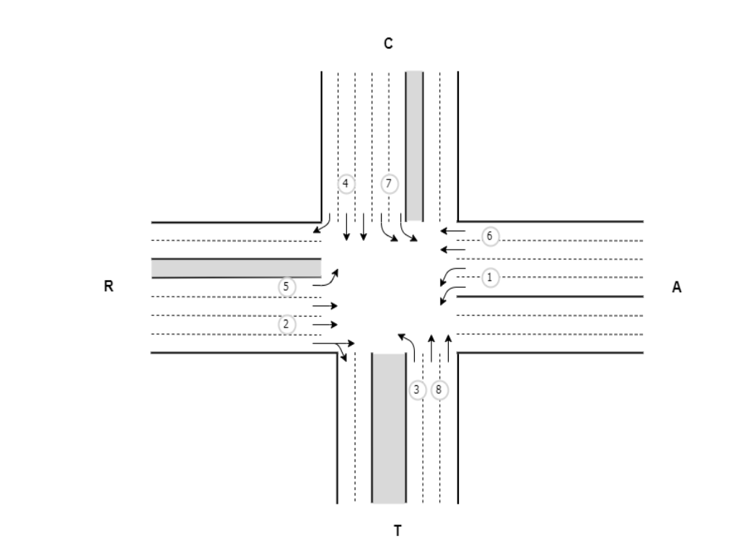
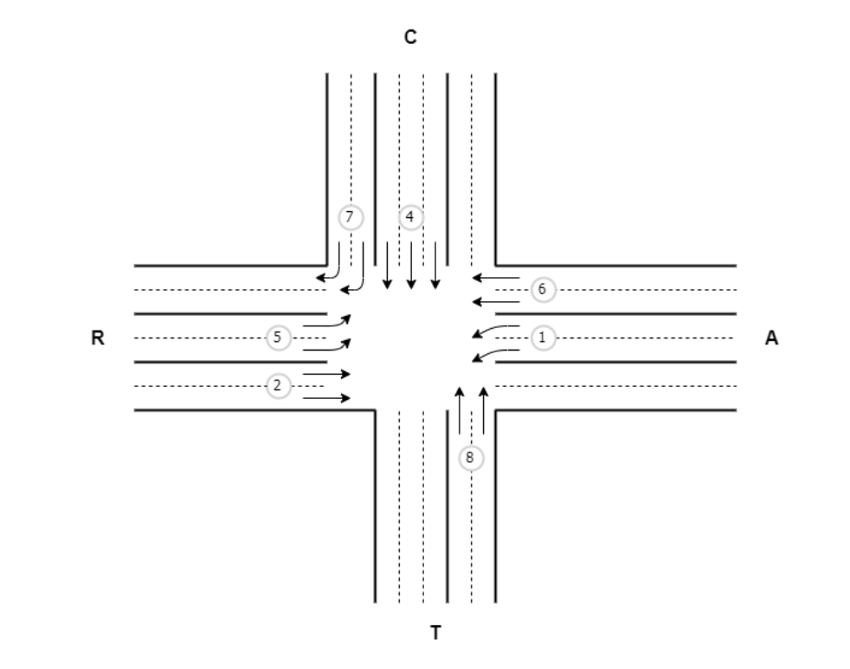

Slide 8
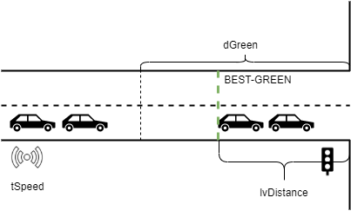
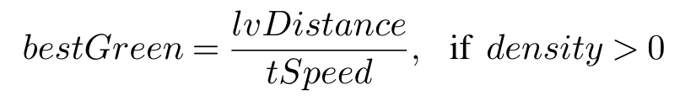


Slide 9
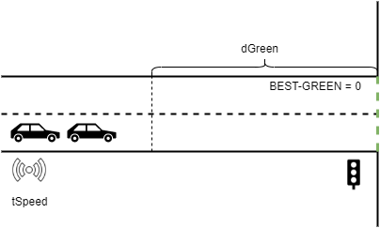


Slide 10
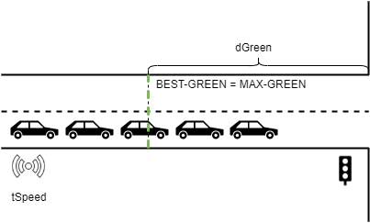

Slide 11
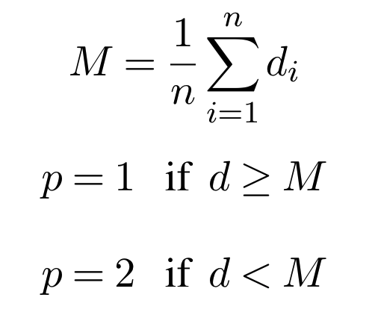
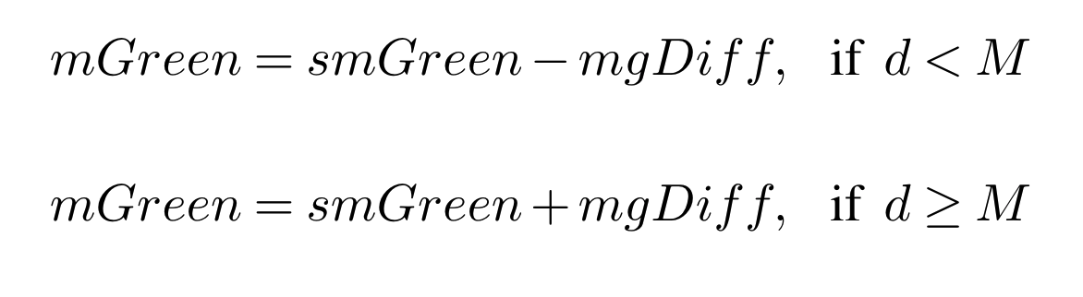
priorities

Slide 12
Data flow
Tallinn’s intersections sensors
Tallinn’s public transportation schedule
Cameras and speed sensors data
Intersection configuration
Generate priority table
Parse data
Create flows, phases, protection phases
Calculate max-green
Calculate max-green
Scheduling algorithm
Algorithm configuration

Slide 13
Performance evaluation
Tammsaare-Sõpruse, Tammsaare-Mustamäe, Endla-Paldiski-Mustamäe intersections
Peak and off-peak hours
Microscopic realistic simulation network in SUMO
One intersection at a time
Realistic traffic demand
Integrated with SUMO’s TSL for baseline results
PETSSA integrated with SUMO using TraCi
Baseline results are compared to PETSSA’s results

Slide 14
Simulation setup
Extensive amount of configuration and coding
Simulation client (Python)
SUMO server
PETSSA (Python)/SUMO TSL

Slide 15
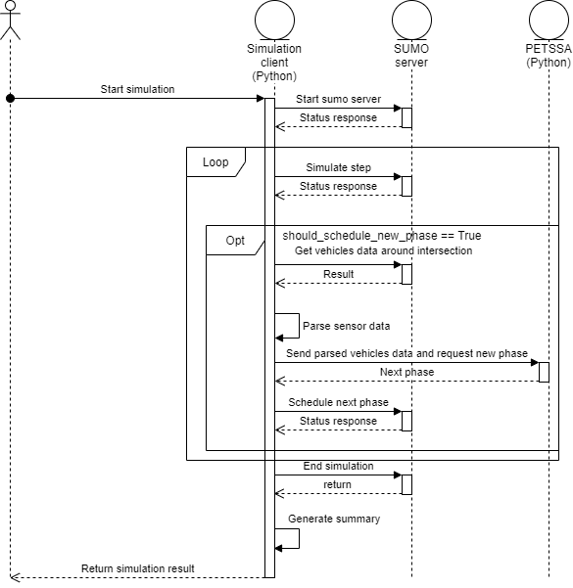

Slide 16
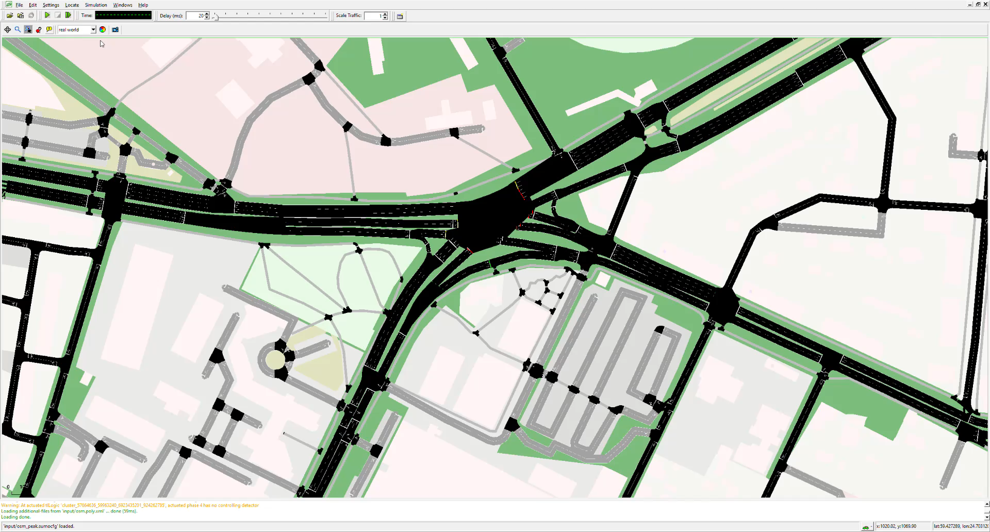

Slide 17
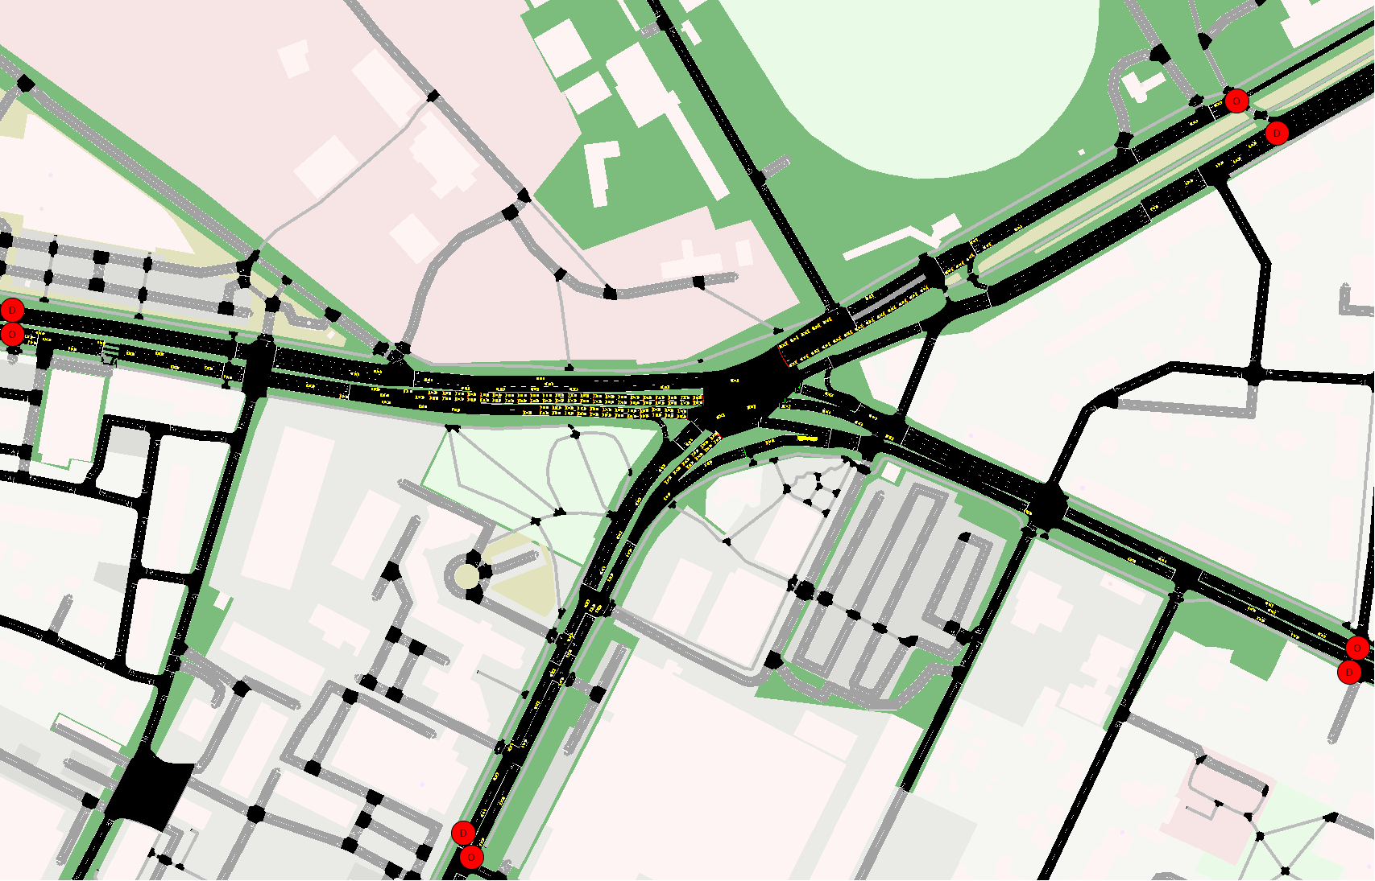

Slide 18
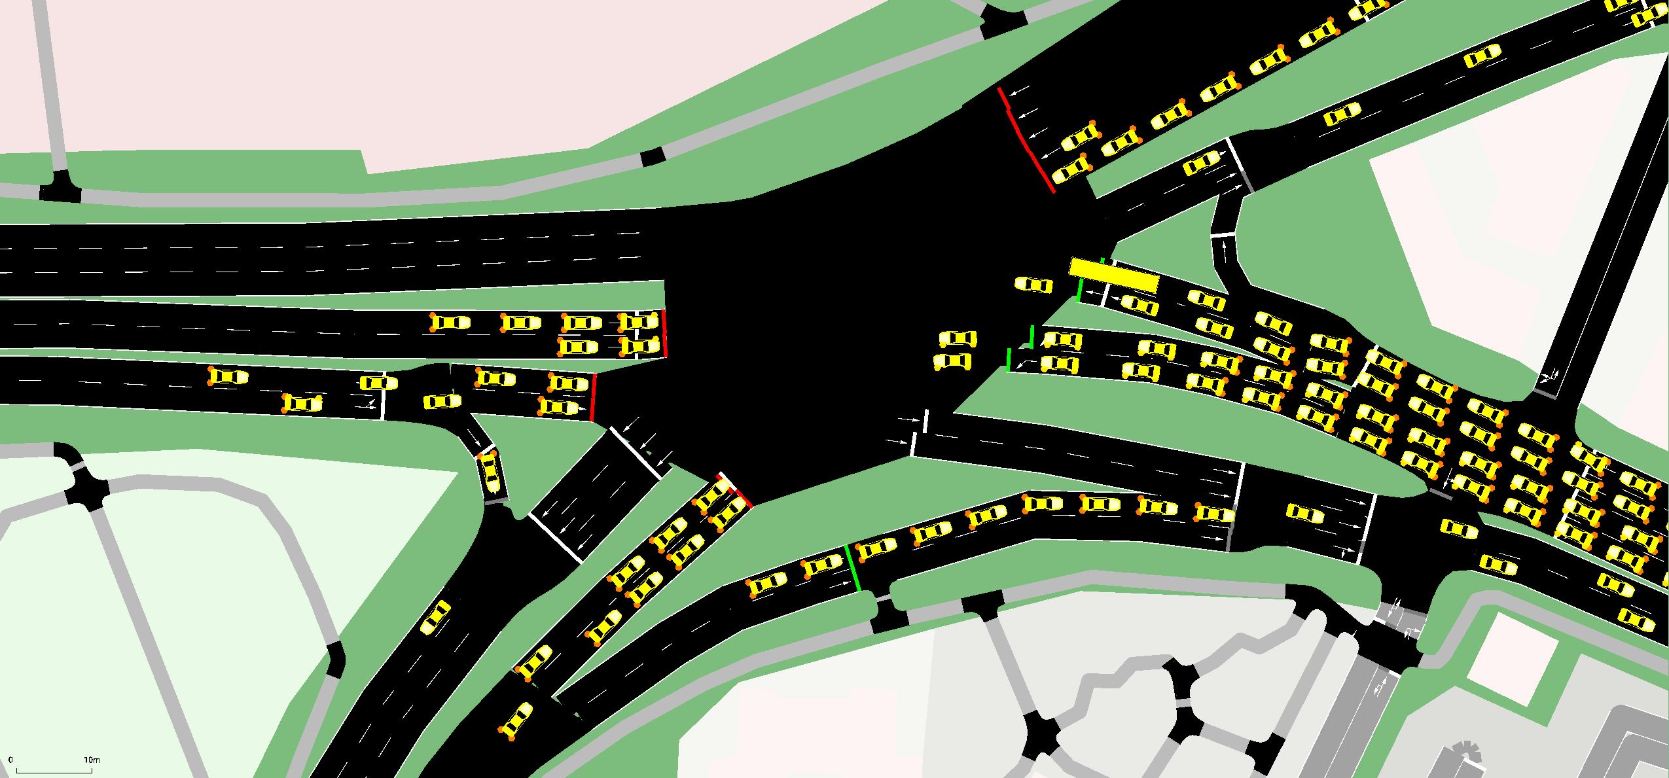

Slide 19
Tammsaare-sõpruse
Scenario | Avg trip duration decrease | Average delay decrease | Total fuel consumption decrease
Peak | 194s -> 129s 33.68% | 116s -> 67s 42.13% | 976l -> 807l 17.3%
Off-peak | 66s -> 60s 8.75% | 18s -> 12s 31.36% | 167l -> 158l 4.86%

Slide 20
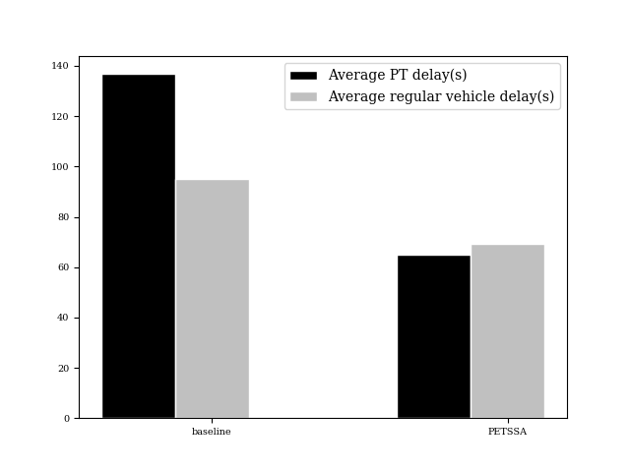
Tammsaare-sõpruse

Slide 21
Tammsaare-Mustamäe
Scenario | Avg trip duration decrease | Average delay decrease | Total fuel consumption decrease
Peak | 127s -> 89s 29.72% | 72s -> 39s 45.20% | 212l -> 200l 5.40%
Off-peak | 69s -> 59s 14.58% | 23s -> 13s 41.18% | 79l -> 76l 3.33%

Slide 22
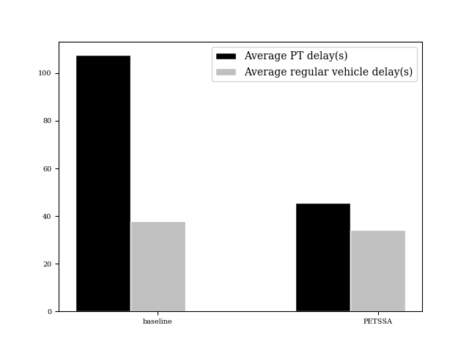
Tammsaare-Mustamäe

Slide 23
Endla-paldiski-mustamäe
Scenario | Avg trip duration decrease | Average delay decrease | Total fuel consumption decrease
Peak | 192s -> 152s 20.52% | 100s -> 66s 33.18% | 1429l -> 1218l 14.73%
Off-peak | 87s -> 76s 12.18% | 19s -> 9s 49.73% | 319l -> 287l 10.12%

Slide 24
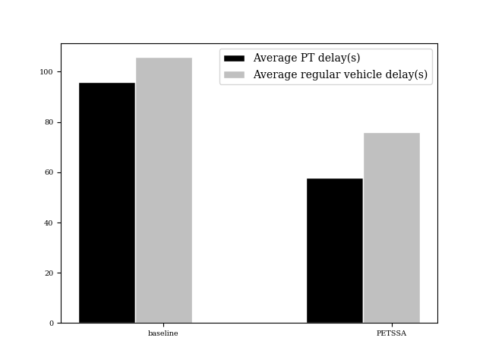
Endla-paldiski-mustamäe

Slide 25
results
Very encouraging results for all three intersections peak and off-peak hours
This is the future
Delay time reduced ~40%
Fuel consumption reduced ~12.5%

Slide 26
Conclusion
PETSSA introduced
Suitable for Tallinn’s intersections
Priority system for public transportation
Performance evaluated in realistic simulation environment SUMO
Three intersections
PETSSA compared to baseline
A step to climate neutral EU (The European Green Deal)

Slide 27
Special thanks
Jaanus Kaugerand
Tallinn City Administration
Raestipendium

Slide 28
further development
Ongoing journal writing
IEEE transactions on intelligent transportation systems (IF=5.744)
Further work
Pedestrians crossings
Traffic incidents
Larger simulation network

Slide 29
references
[1] Bani Younes, M. and Boukerche, A. (2017). An efficient dynamic traffic light schedulingalgorithm considering emergency vehicles for intelligent transportation systems.Wireless Net-works, 24.
[2] Younes, M. B. and Boukerche, A. (2016). Intelligent traffic light controlling algorithms usingvehicular networks.IEEE Transactions on Vehicular Technology, 65(8):5887–5899.

Slide 30
Thank you! Questions?

